Slide 1


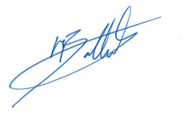
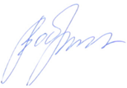


ControlTech s.r.o.
has achieved
Rockwell Automation PartnerNetworkTM
certification as an
Authorized Service Provider
Mark Bottomley
VP Market Access EMEA
Vladimir Obrazcov
VP Lifecycle Services EMEA
2026 Annual Membership

